Slide 1
Data Quality

Slide 2
Data Quality
Data quality metrics are the measurements by which you assess your business data.
They benchmark how useful and relevant your data is, helping you differentiate between high-quality data and low-quality data.

Slide 3
1.Uniqueness : It will check the uniqueness of the data that means it will check if any duplicate rows. 2.Completeness : It will check if any rows in our dataset will have missing values or not. 3.Validity : It will check each column having only required data or not based on domain specification. For example if we consider gender we can conclude it domain has only male and female values. 4.Consistency : Maintaining synchronicity between different databases is essential. To ensure data remains consistent on a daily basis, software systems are often the answer.
Metrics

Slide 4
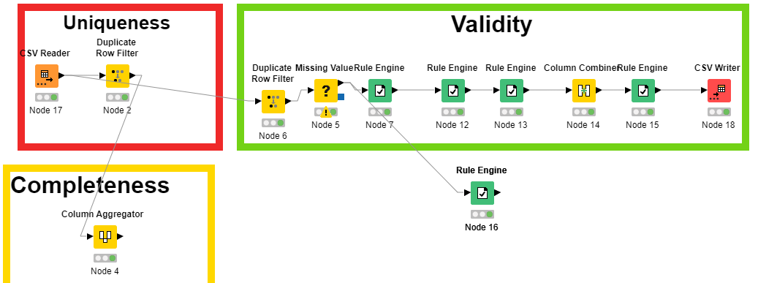
Achieved These Metrics By Using Knime Tool

Slide 5
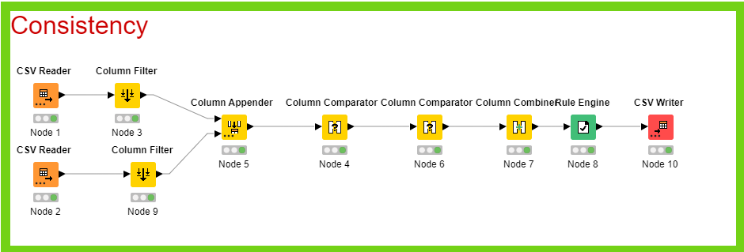

Slide 6
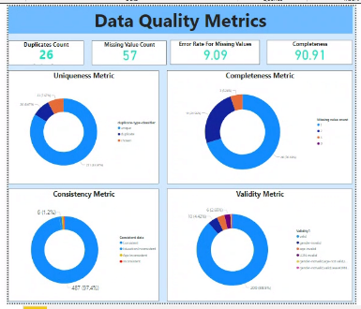
Data Quality Metrics Dashboard
https://app.powerbi.com/groups/me/reports/e0f44dc7-d01a-4ce0-93d4-a670f1894169/ReportSection

Slide 7
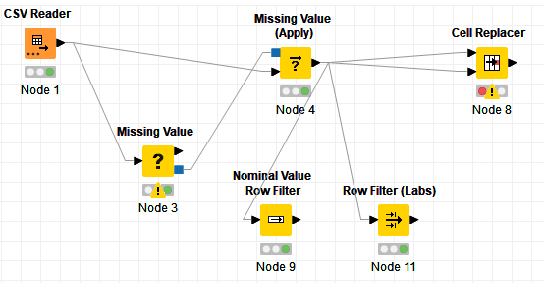
Data Cleansing
Data cleansing is the process of identifying and resolving corrupt, inaccurate, or irrelevant data.
Handled missing values
Handled name spaces
Handled date format

Slide 8
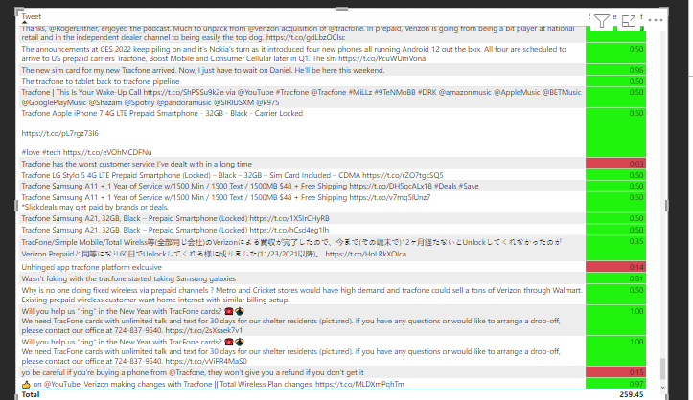
Sentiment Analysis In Power Bi

Slide 9
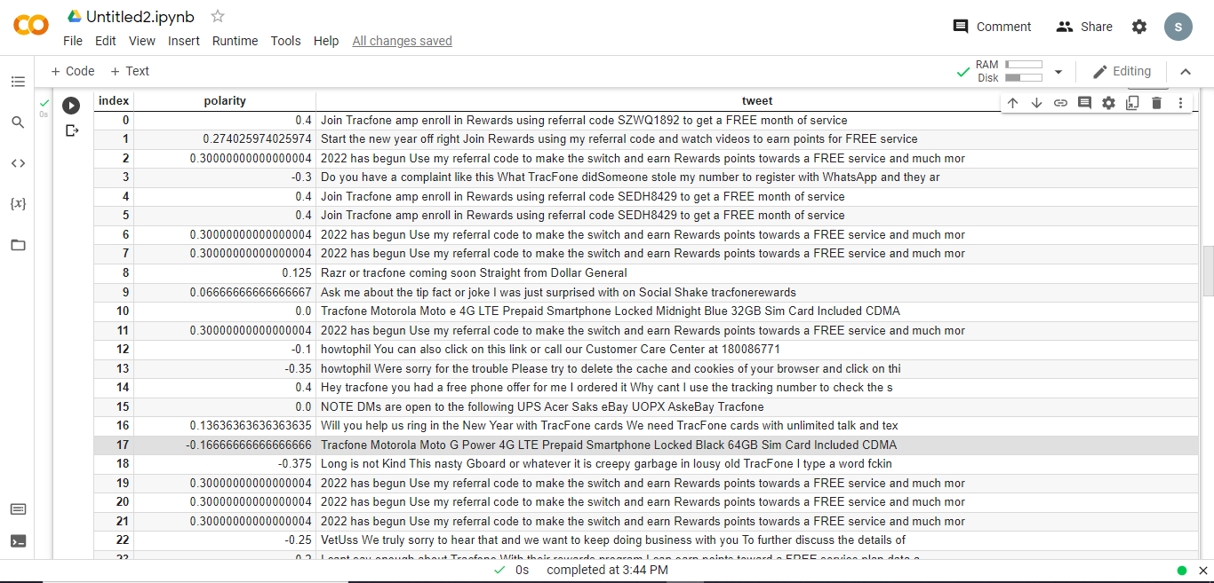
Sentiment Analysis In Python
https://colab.research.google.com/drive/1yVPpvZYNC-MoQ7QWyJMn9xpVYgOWlL39#scrollTo=eSnUezi9gccy

Slide 10
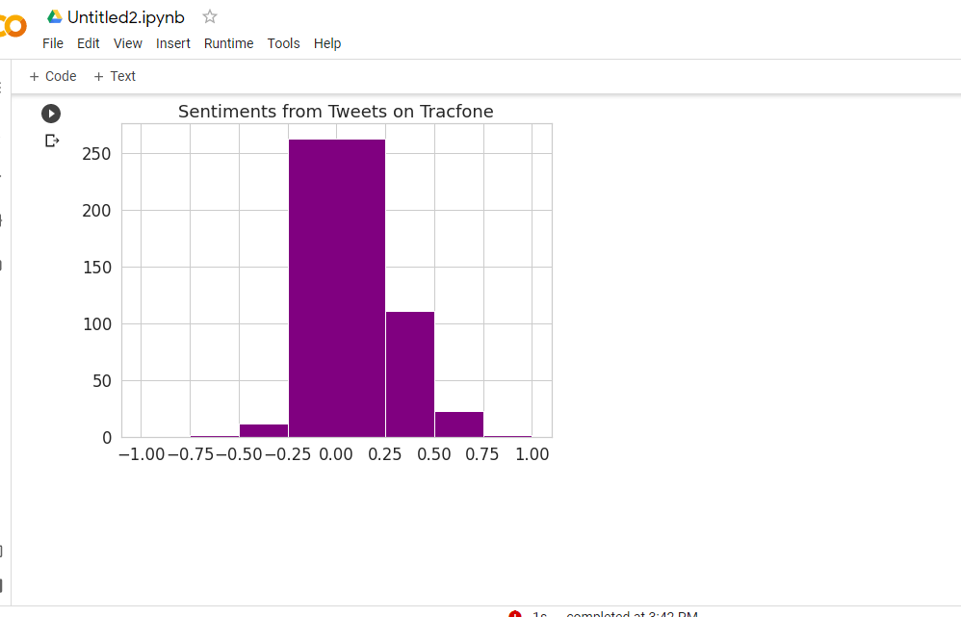
Histogram of Tweets
https://colab.research.google.com/drive/1yVPpvZYNC-MoQ7QWyJMn9xpVYgOWlL39#scrollTo=eSnUezi9gccy

Slide 11
Data Lineage

Slide 12
Data Lineage
Data lineage is the process of understanding, recording, and visualizing data as it flows from data sources to consumption.
Includes all transformations the data underwent along the way—how the data was transformed, what changed, and why.

Slide 13
Data Lineage In Power BI
Power BI has several artifact types, such as dashboards, reports, datasets, and dataflows. Many datasets and dataflows connect to external data sources such as SQL Server, and to external datasets in other workspaces. When a dataset is external to a workspace you own, it may be in a workspace owned by someone in IT or another analyst. External data sources and datasets make it harder to know where the data is coming from.
In lineage view, you see the lineage relationships between all the artifacts in a workspace, and all its external dependencies. It shows connections between all workspace artifacts, including connections to dataflows, both upstream and downstream.

Slide 14
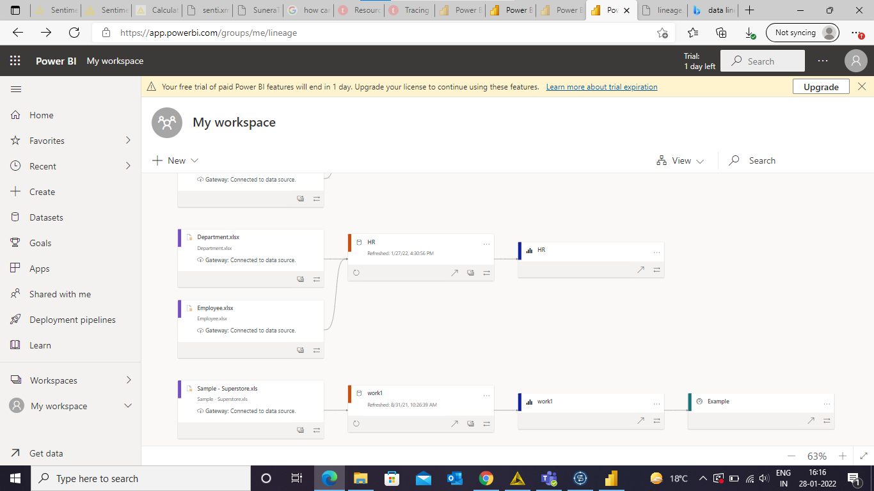
To access lineage view, go to the workspace list view. Tap the arrow next to List view and select Lineage view.

Slide 15
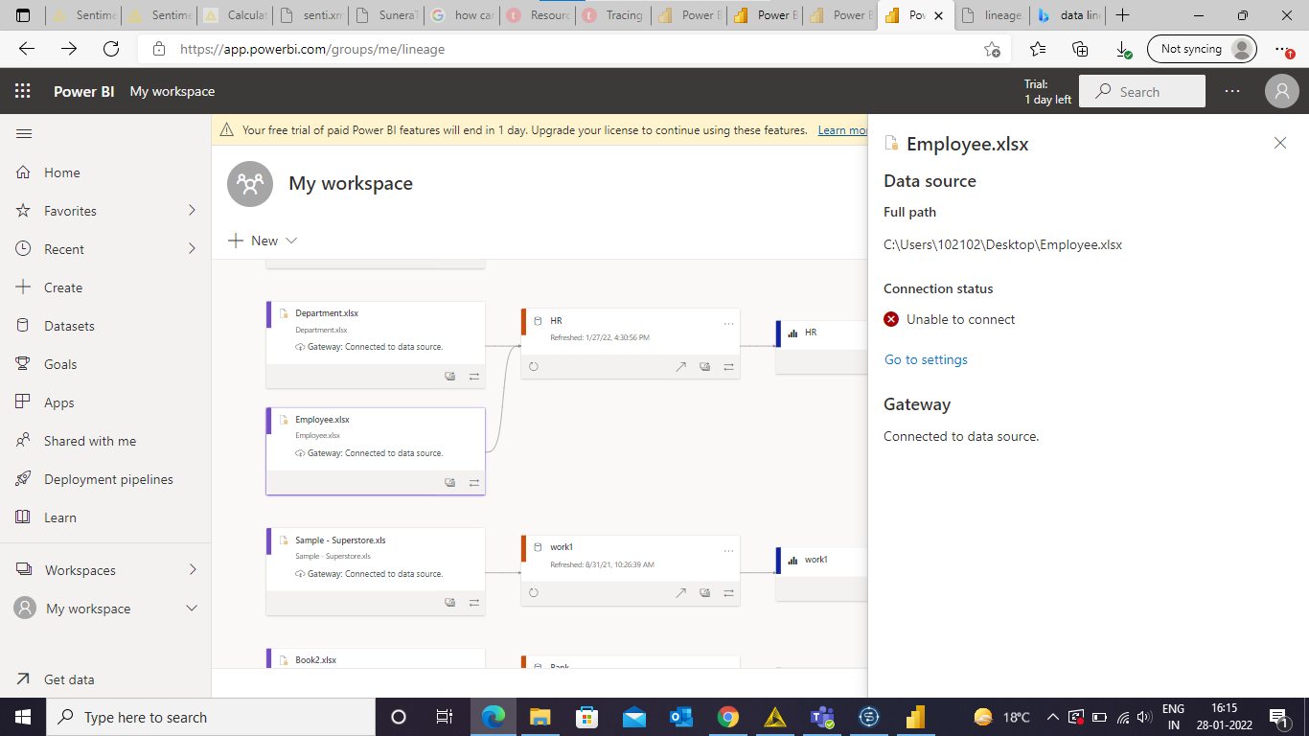

Analysis of Nodes in Lineage
Power BI

Slide 16
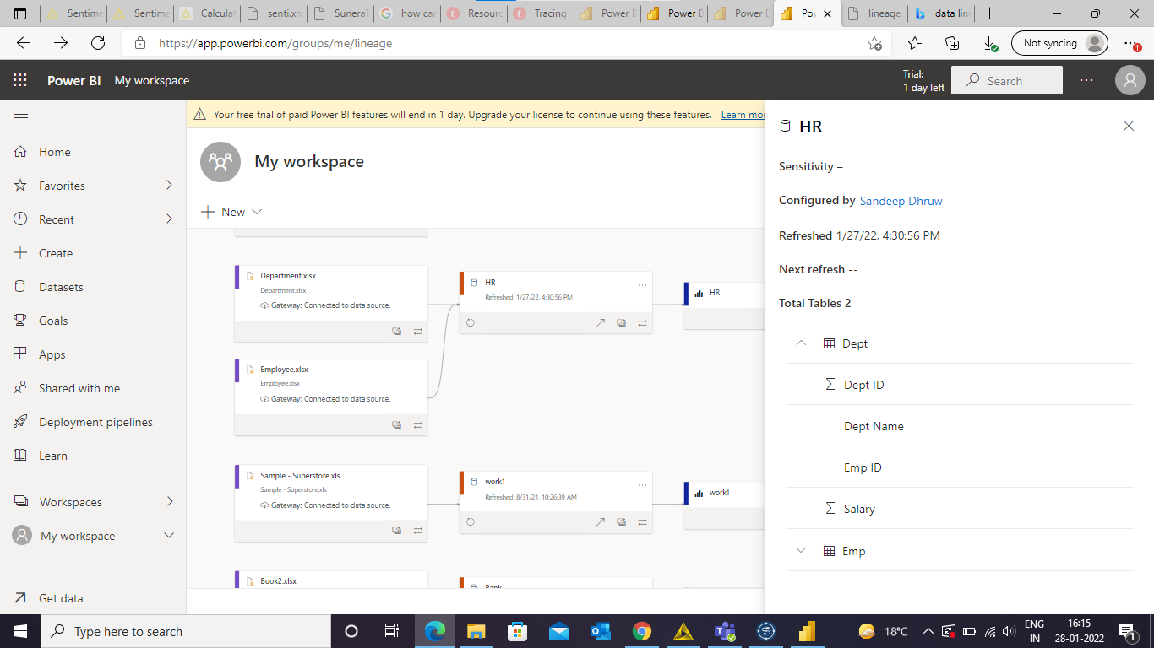
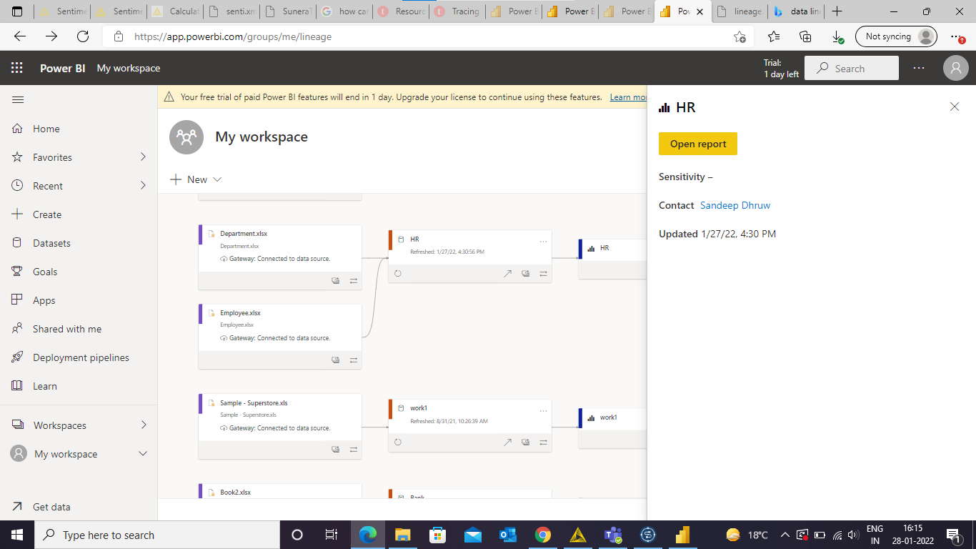
Analysis of Nodes in Lineage
Power BI

Slide 17
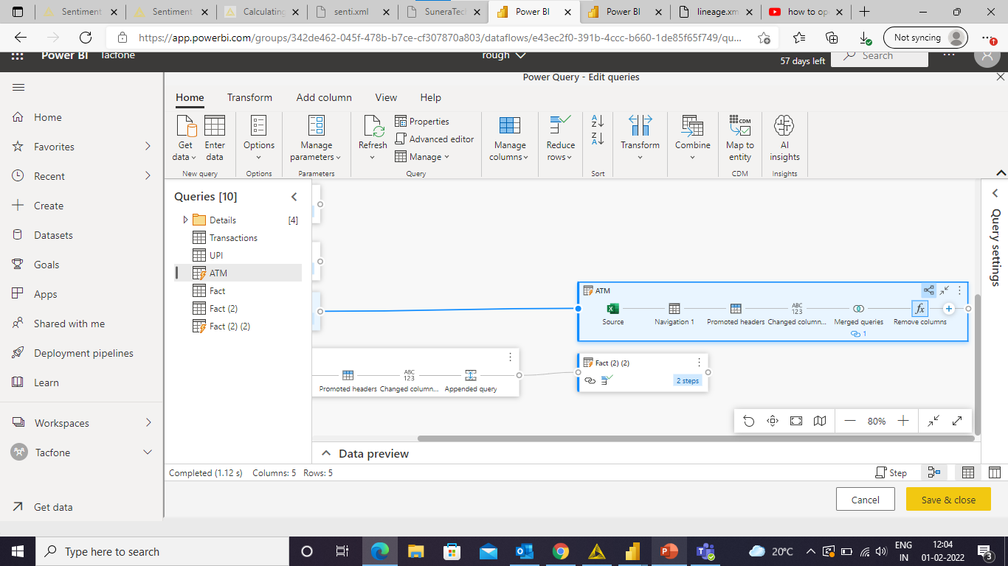
Online Power Query editor also provides you diagram view for tracing the applied steps/relations on Data’s

Slide 18
Data Lineage In Collibra
Extract and maintain lineage automatically from source systems, SQL dialects, ETL tools and BI tools.
Trace data flows with an interactive lineage diagram that shows summary lineage from source to destination.
View detailed technical lineage at the table, column, transformation and SQL query levels to quickly understand the impact of potential changes.
View direct data flows across data assets as well as indirect relationships to get a complete picture of data dependencies.

Slide 19
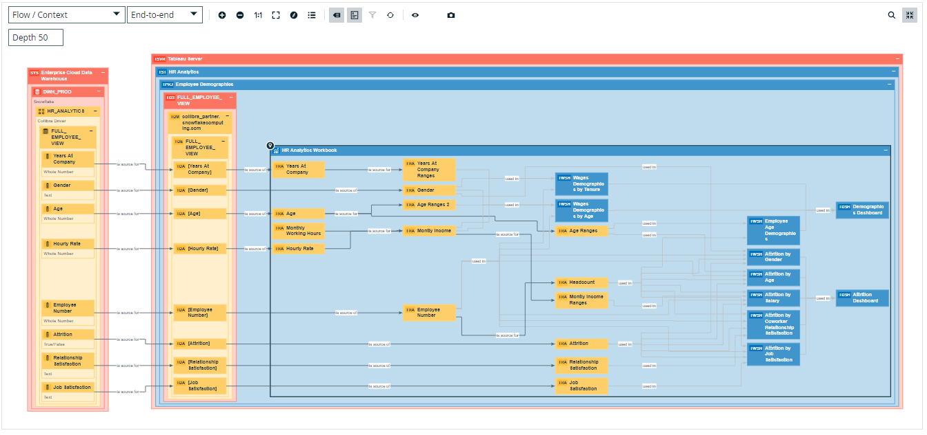
Diagram View which represent the final Dashboard(right end) uses worksheets and those worksheet uses attributes from data sources coming from Data warehouse of snowflake server.

Slide 20
Metadata Management

Slide 21
Metadata management is the business discipline of managing the metadata about data. It gives meaning to and describes the information assets in your organization. Metadata unlocks the value of your data by improving that data’s usability and findability.
Metadata gives basic information about data—including file type, time of creation, size of file, author, and more.

Slide 22
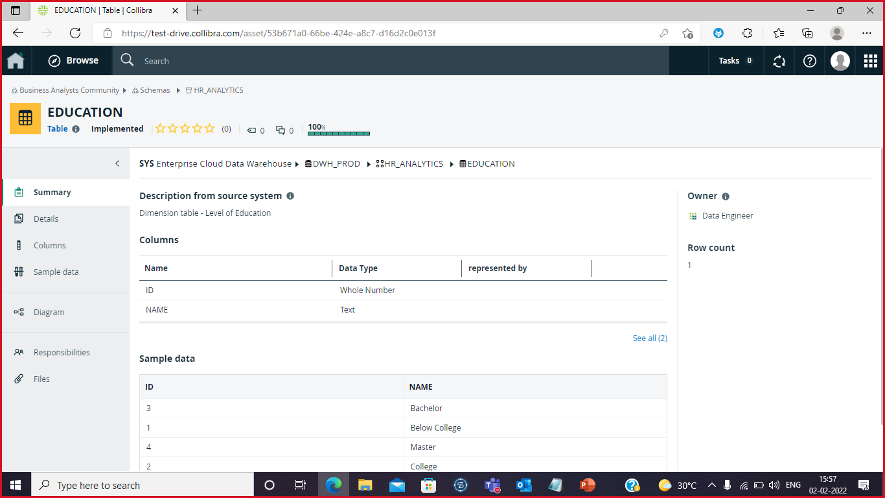
We can select a data source from data catalog. Then we can see the metadata about the data.

Slide 23
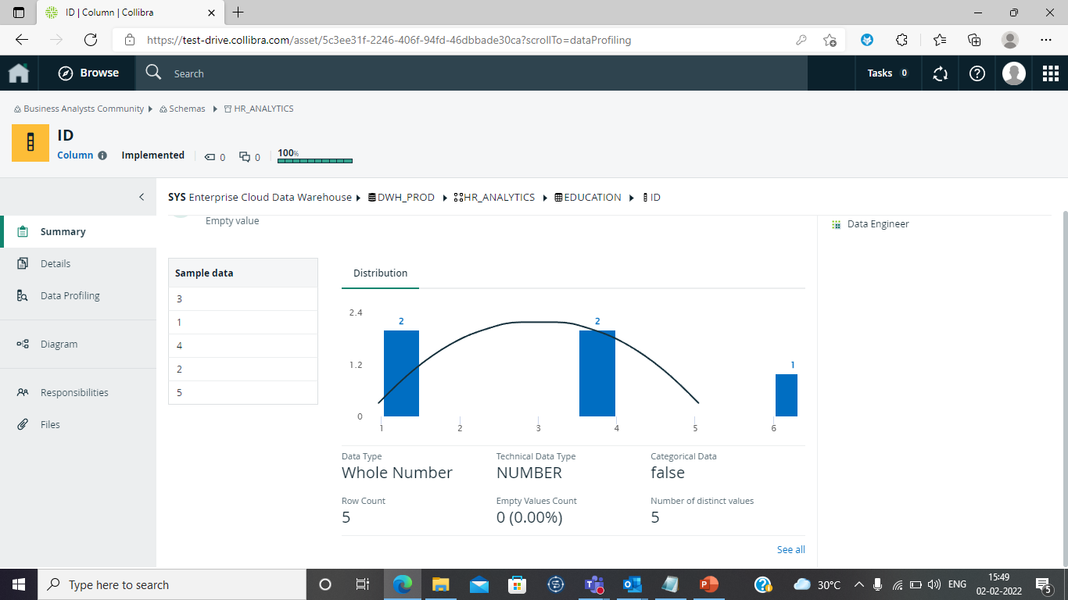
Here, we can check the data type , number of rows and empty values count. We can check particular column data type, and length.

Slide 24
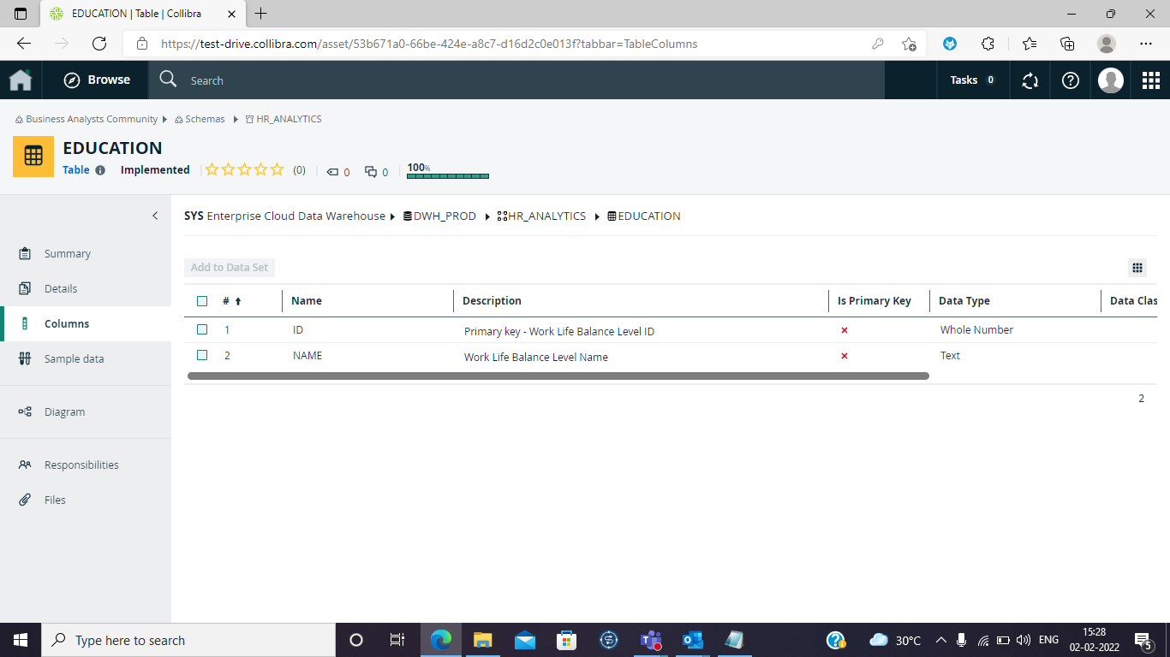

Slide 25
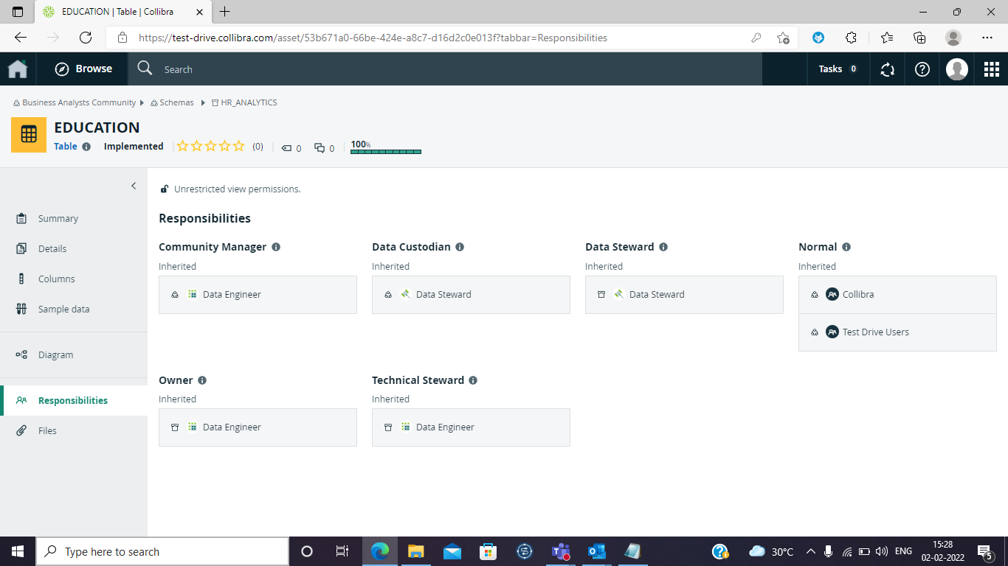
We can check here who has what responsibilities.
Data Engineer: They are responsible for grabbing the information and set up in the catalog.
Data Steward: They are responsible for making everything is correctly organized, quality of the data and data governance.

Slide 26
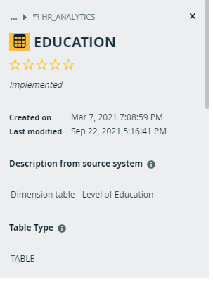
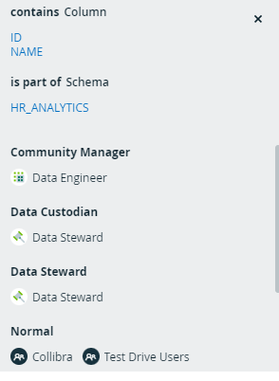
Metadata for education

Slide 27
Data Integration

Slide 28
Data integration involves combining data residing in different sources and providing users with a unified view of them. This process becomes significant in a variety of situations.

Slide 29
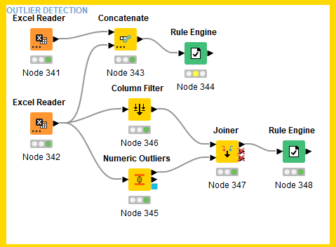
Outlier detection: Outlier detection is used to find the outliers in the data we can find using numeric_outliers node in the knime.

Slide 30
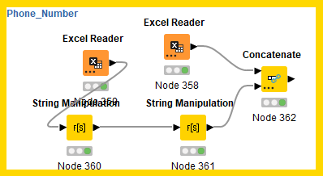
Phone number: In these different notations of phone number from different files and convert it into one type using knime tool.

Slide 31
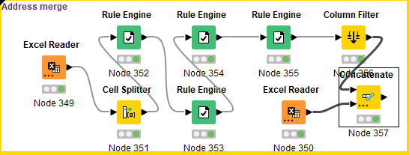
Address merge: in these different notations of address from different files and convert it into one type using knime tool.

